Slide 1
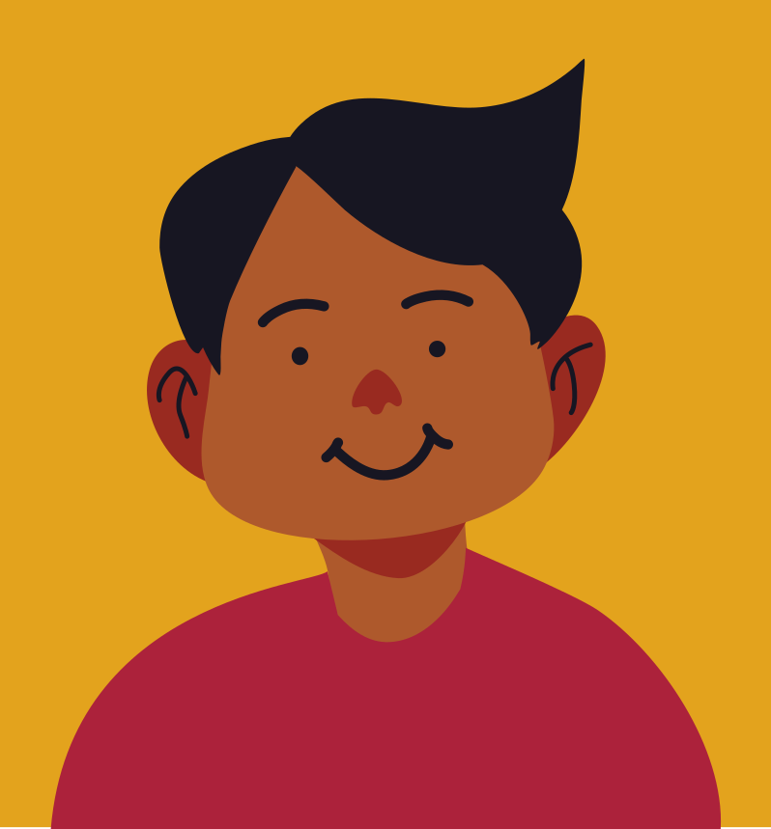
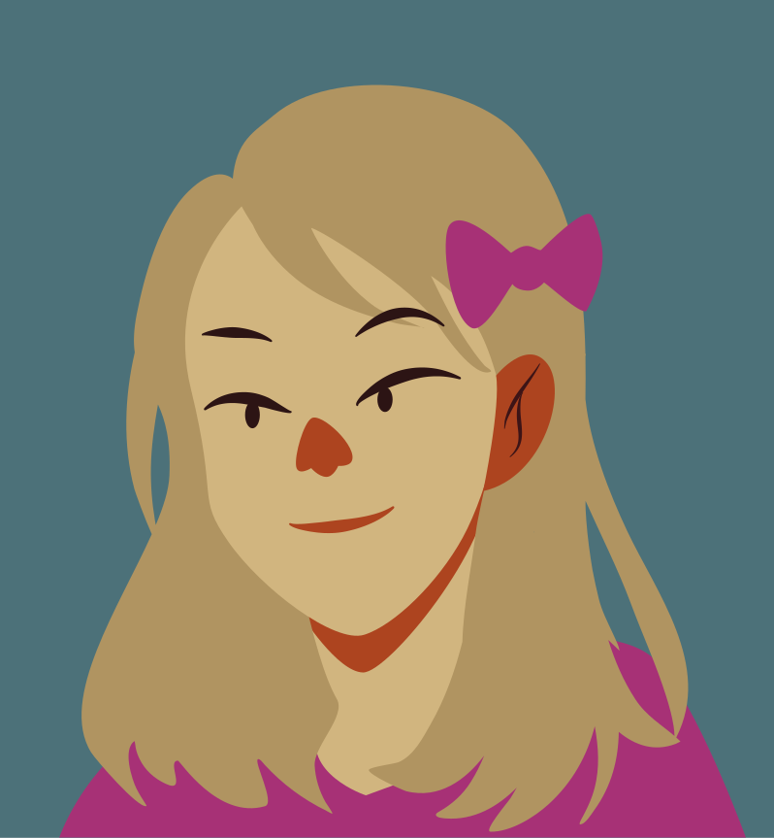
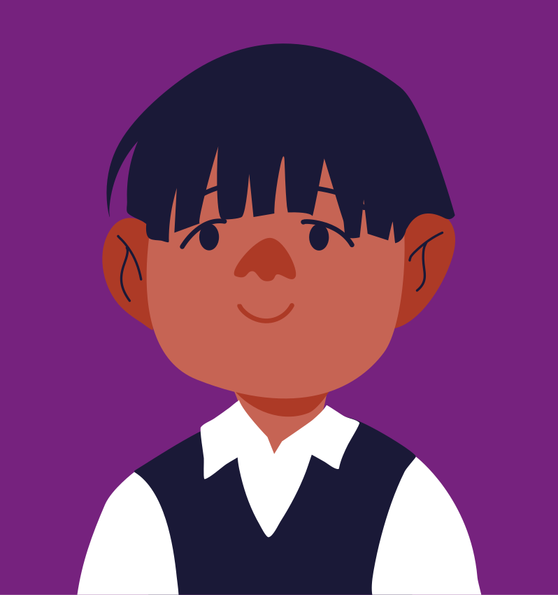
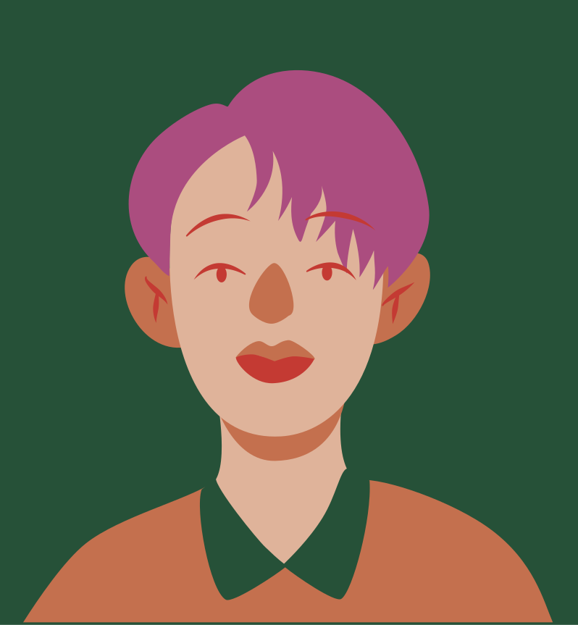
Effective Communication
有效沟通
Talking with our children
与我们的孩子交谈

Slide 2
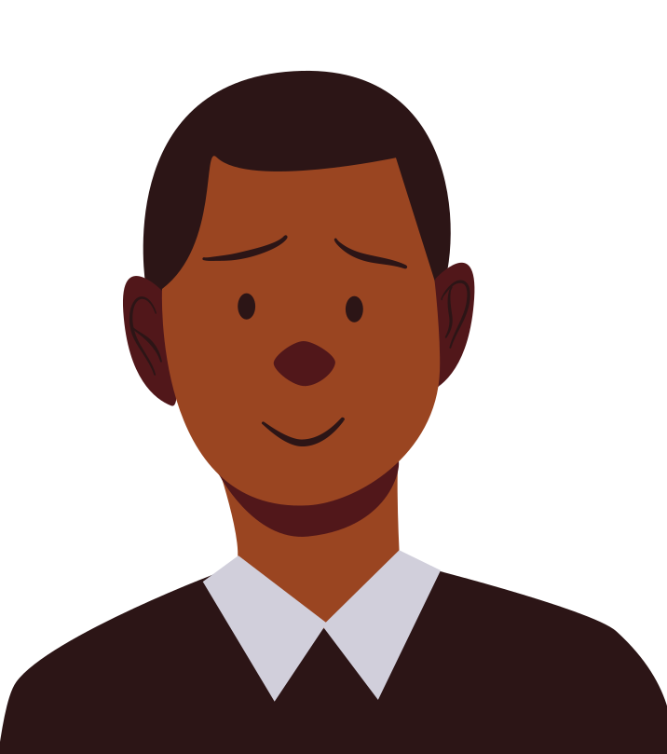
Agenda
议程
1
Being an Emotion Coach
3
Parallel Position Moments
6
Age-Appropriate Communication Techniques
成为一个情绪教练
平行位置时刻
年龄恰当的沟通技巧
2
Active Listening
4
Creating Talking Rituals
积极聆听
7
Love Languages
创造谈话仪式
爱的语言
5
Controlling our Responses
控制你的反应

Slide 3
Sound Familiar?
熟悉？

Slide 4
Understanding Feelings
情绪理解
what we see and hear from students
Being an
EMOTION COACH
我们听到和看到的情况
helping them through emotional situations
帮助他们度过情绪化的时刻
成为一个
情绪教练
encouraging open communication
鼓励开放式沟通
judgement-free zone
无指责的空间
Notes:
Lana: What the workshop is based on (research and what we see as teachers and the counsellor)
Being an emotion coach is about helping children understand their own feelings and supporting the through emotional situations.

Slide 5
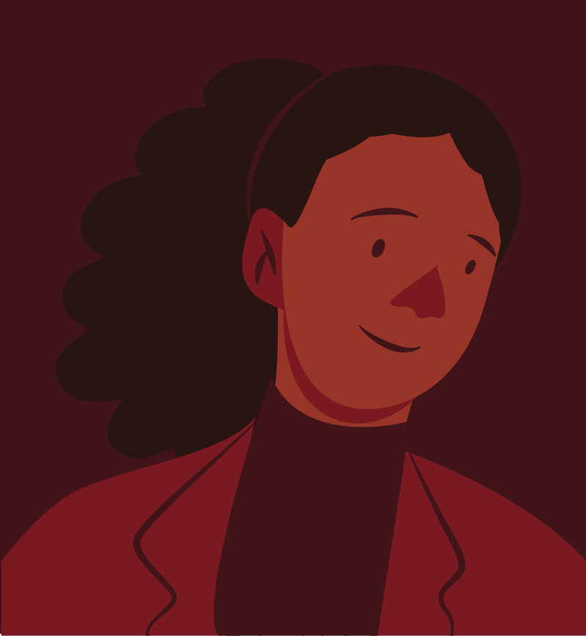
Observe and make note of your children's emotions.
觉察和记录孩子的情绪
look for teachable moments.
寻找教育时刻
Respond with empathy.
共情地回应
Help children label their different emotions.
帮助孩子标识他们的情绪
Notes:
Lana: Strategies: How to be an emotion coach

Slide 6
Activity #1
Your 7-year-old son comes home from playing next door. When he comes inside, he throws his coat on the floor without hanging it up. What can you say and do?
While having a conversation with your child, their tone and posture you find disrespectful/aggressive. What can you say and do?
你7岁的儿子从隔壁玩回来。 当他进来时，他把外套扔在地板上，没有把它挂起来。 你会怎么说和做？
在和孩子交谈时，他的语气和姿势让你觉得不尊重/咄咄逼人。 你会怎么说和做？
Notes:
Example #1:
Parent: Nate, what's going on? You always remember to hang up your coat. Did something happen at Stuart's?
Child: I hate him! I'm not playing over there anymore.
Parent: You sound really angry. What happened?
Child: Stuart never lets me play with his new train.
Parent Why do you think that is?
Child: I don't know. He says I'll break it.
Parent: Well, I can understand why you are mad, but you know Stuart just got the train for his birthday last month. He's probably scared to let anybody else use it. What do you think you can do to let him know you'll be careful with it?
Child: I don't know.
Parent: Well, instead of getting angry, maybe you could tell him that you understand why he is being careful and ask him to show you exactly what he wants you to do. Let him know that you'll be careful. If he says no, you might just have to wait longer, but at least you tried.
Child: Yeah, I know.
Example #2:
Parent: I think / I feel /
Child:

Slide 7
Practice Active Listening
练习
积极聆听
give your full attention to your child
给孩子全部的关注
make eye contact
眼神交流
stop doing other things
停下在做的事
get down on your child’s level
降到孩子的高低
repeat back to show understanding
复述和回应，以表示理解
Notes:
Mirjam: Let your child know you are interested in what she has to say.
It can be tempting to brush off our children’s problems, especially if we have had a bad day or if we are busy. But our children need to know that we are going to listen to them. This will make it more likely our children will talk with us about their hopes and problems when they are older. Here is an example.

Slide 8
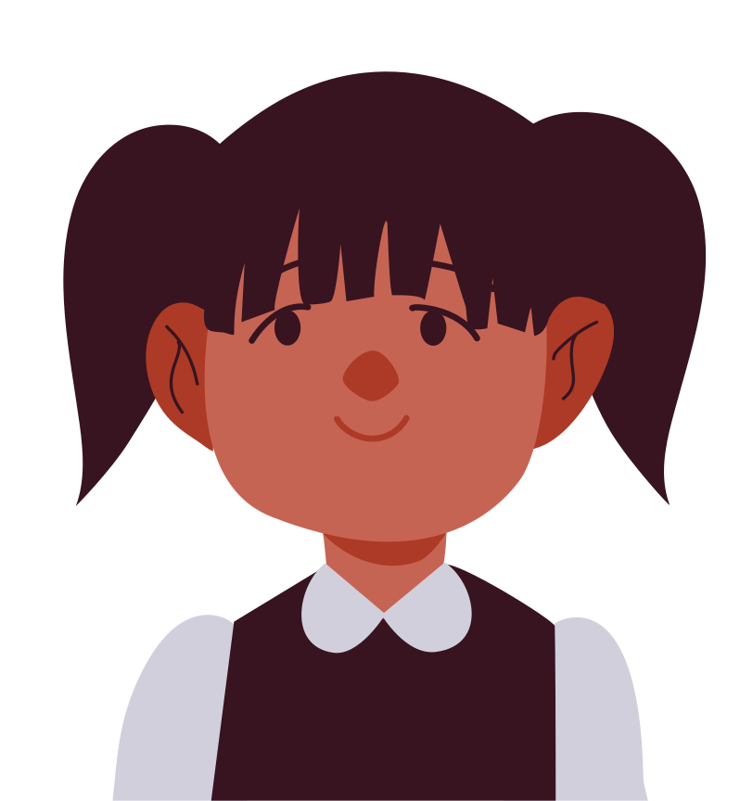
You pick up your daughter from preschool. She is crying and tells you that her friend took her favorite toy and stuck out his tongue at her.
Practice Active Listening:
“It seems like you are sad about your friend taking your favourite toy.” Your daughter continues to cry, nods her head, and says that she thinks her friend will break the toy.
“So you are scared that your friend might break your toy?” As she calms down, you and your daughter continue to talk, so that she knows that it is okay to be upset.
She has begun to learn how to label and cope with her feelings by talking to someone.
Notes:
Mirjam: Let your child know you are interested in what she has to say.
It can be tempting to brush off our children’s problems, especially if we have had a bad day or if we are busy. But our children need to know that we are going to listen to them. This will make it more likely our children will talk with us about their hopes and problems when they are older. Here is an example.

Slide 9
你从学前班接你的女儿。她哭着告诉你，她的朋友拿走了她最喜欢的玩具，并向她吐舌头。
练习积极聆听：
“你似乎很伤心，因为你的朋友拿走了你最喜欢的玩具。”你的女儿继续哭泣，点头，说她觉得她的朋友会弄坏玩具。
“所以你害怕你的朋友会弄坏你的玩具？”当她冷静下来时，你和女儿可以继续说话，这样她就知道不高兴是可以的。
她已经开始学习如何通过与某人交谈来标记和应对自己的感受。
Notes:
Mirjam: Let your child know you are interested in what she has to say.
It can be tempting to brush off our children’s problems, especially if we have had a bad day or if we are busy. But our children need to know that we are going to listen to them. This will make it more likely our children will talk with us about their hopes and problems when they are older. Here is an example.

Slide 10
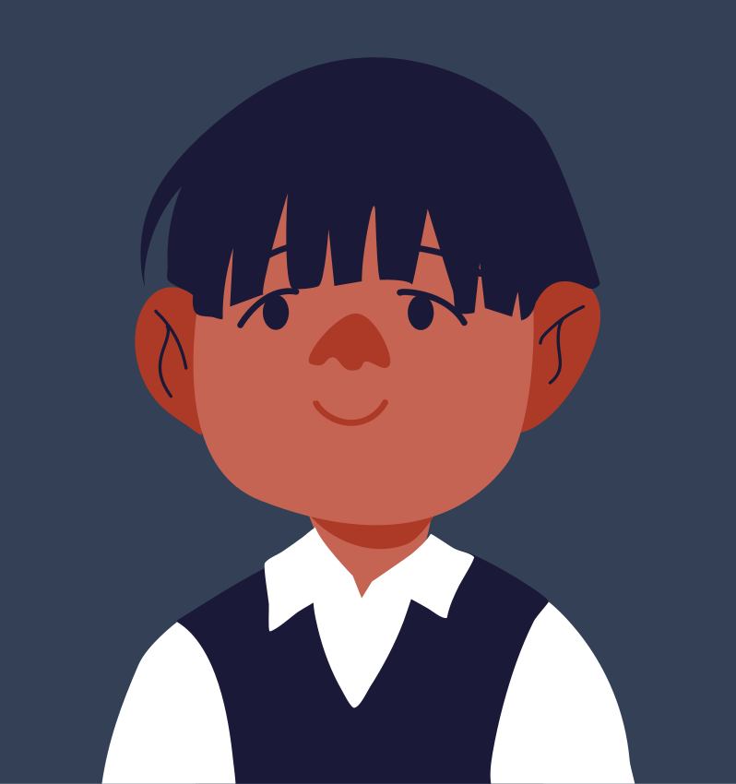
Parallel Position Moments
平行位置时刻
Notes:
Vivian: “What were you doing the last time you had a good conversation with your child? I know the answers: walking or driving to school, baking together, bath time, and, of course, bedtime. These times and activities loosen tongues because parent and child aren’t looking at each other. In fact, we are in parallel position. Most of us think talking is supposed to be about relating deeply, but kids actually open up in the middle of doing other things, during what I refer to as the “in-betweens” of life.”- Dr. Rob Taffel
Parallel Position moments enable difficult conversations to happen

Slide 11
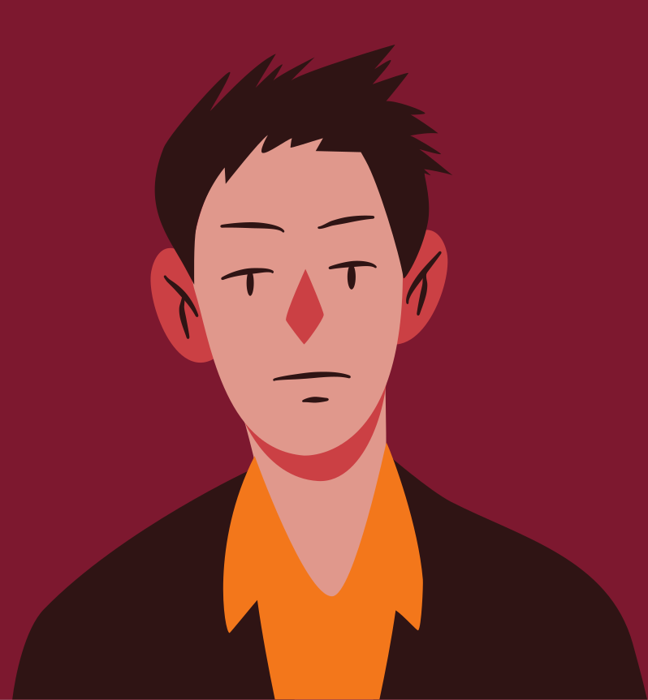
Create Talking Rituals
创造谈话仪式
How do kids spell love?
你的孩子怎么表达爱？
T
I
M
E
Be intentional about spending one-on-one time with your child
有意识地与孩子一对一地相处
Notes:
Lana: Be intentional about spending one-on-one time with your child
Play a game
Build a puzzle
Get on their level
Get to know their interests
Let them teach you to do something they love (my son asked me if he could teach me how to use an XBOX controller and was thrilled when I said yes)

Slide 12
Share Your Stories
分享你的故事
and teach them to listen
并教会孩子聆听
“High-Low-Buffalo”
“高低大公鸡”
Notes:
Lana: “High-Low-Buffalo” :
Everyone gets a turn.
Everyone tells their HIGH from the day, also known as the best thing that happened that day.
Everyone tells their LOW from the day, which is generally something that made them upset. (The responses to what their LOW was are sometimes quite amusing if they’ve actually had a great day overall.)
Finally, everyone tells their BUFFALO, which is just something random from the day that they want to share. A variation of this game is High-low-interesting.
Parents can model how to share and to help kids learn to listen. It may trigger a memory from their day they want to share, and it can help spark deep conversations about problem solving through difficult moments
This is big in our child-centered world. Talk about yourself if you want your kids to talk about themselves.
For example, if you say, “I had a tough day at work because I had a disagreement with a co-worker, but we found a way to talk through it,” your child might respond on their turn, “I had a fight with Jenny during P.E.”
And a special note about dinnertime: grill the food not your kids. Endless queries such as “How was school?” are conversation-busters.

Slide 13
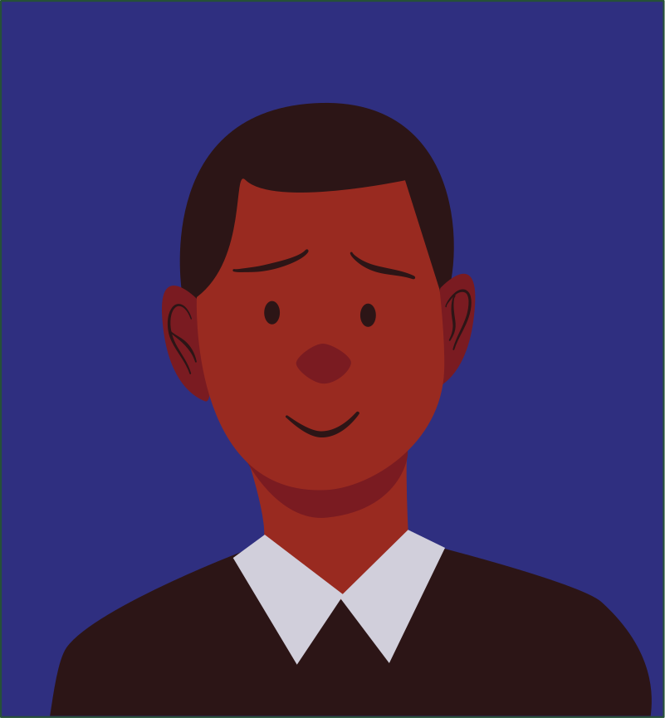
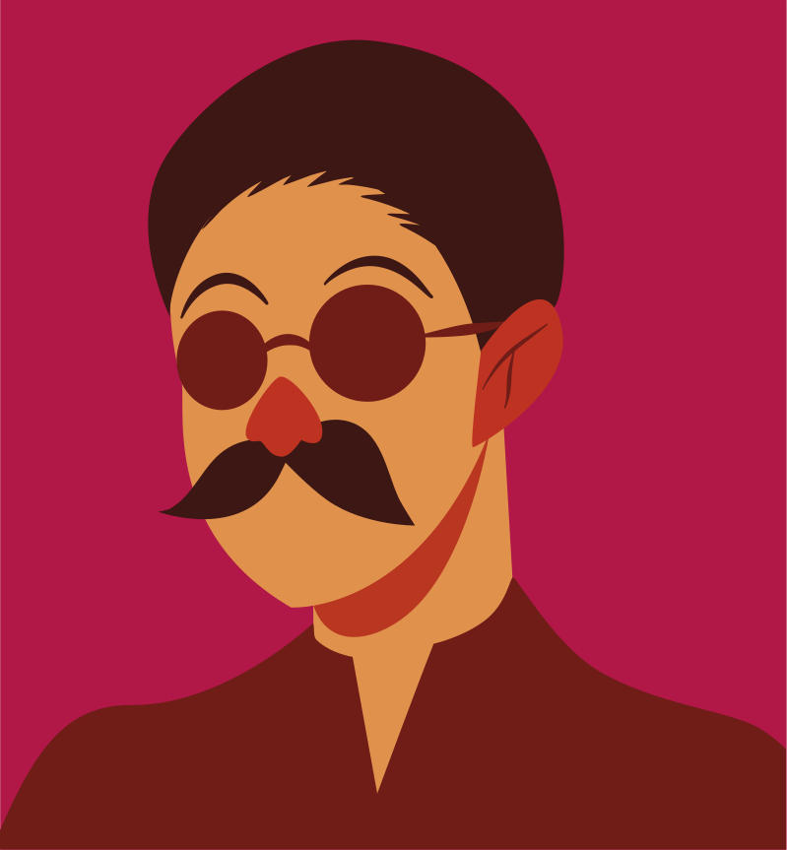
Control your Response
控制你的回应
Positive communication with children relies a lot on how you control your emotions.
与孩子的积极沟通很大程度上取决于你如何控制自己的情绪。
Notes:
Lana: Children can say and do things that can provoke an emotional response from you. Positive communication with children relies a lot on how you control your emotions.
Refrain from saying words that you may regret later. Control strong outbursts and try to remain calm – especially when bad behaviour occurs.
Counting to 10 before responding to a child can be a great way to help diffuse emotions, before speaking them out.
The shouting match - Lana

Slide 14
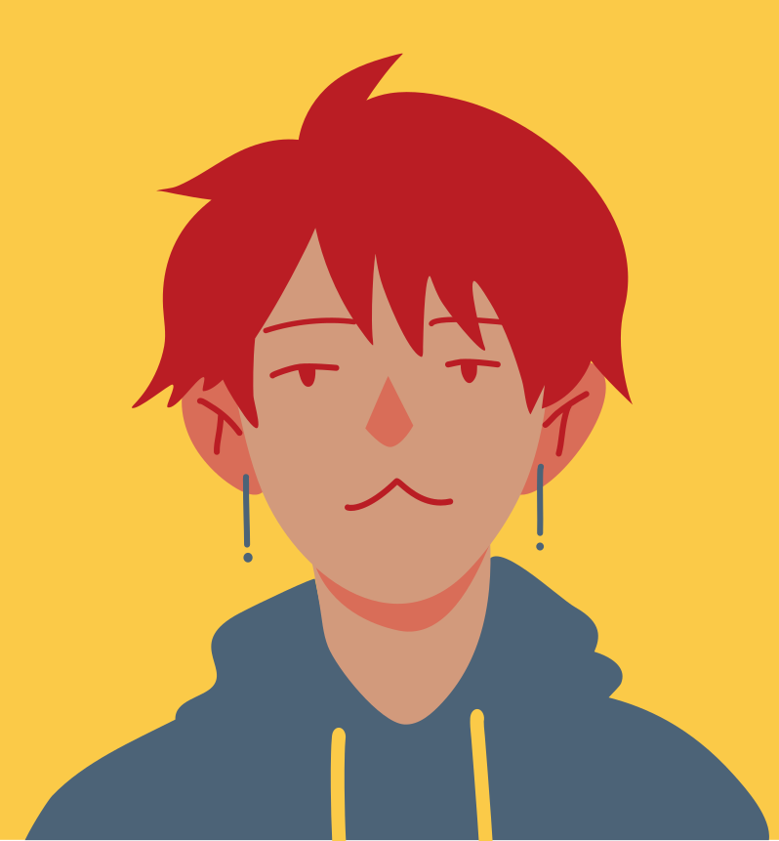
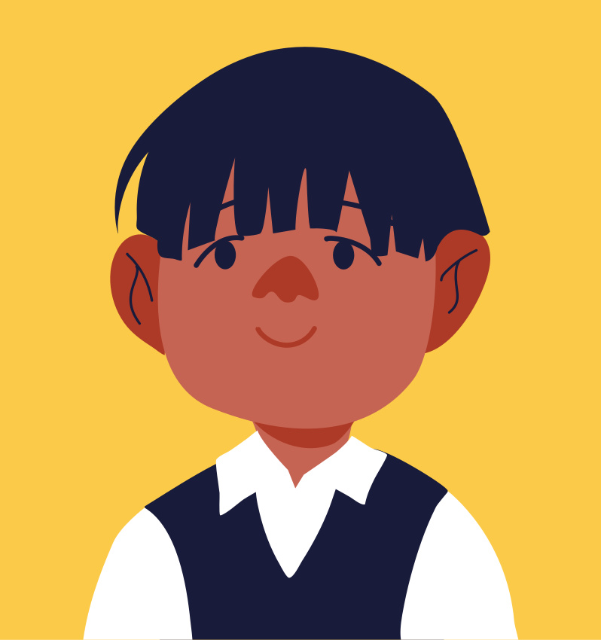
Use Age-Appropriate Communication Techniques
使用年龄恰当的沟通技巧
How to talk to your child at every age
怎么和不同年龄的孩子讲话

Slide 15
Age-Appropriate Communication Techniques
0-2 Years
3-5 Years
6-11 Years
12-18 Years
Touch is the first form of communication
Use tone and body language to enhance what you say.
Respond to baby talk with conversation.
Talk to your child even if they don't understand.
Give your child your complete attention.
Watch your tone and body language.
Help your child to put words to his emotions.
Offer limited choices and simple explanations
Make time to talk
Speak to your child in a respectful manner
Ask specific questions to learn more and to keep children talking
Listen without contradicting; then repeat what you heard
Allow your child to have some input in family rules.
Laugh with your child and admit your mistakes.
talk with your teen - not at him.
Show respect to your teen's opinions.
Find opportunities to talk (car rides, walks)
Respect your teen's privacy and keep their confidences.
Show that you trust your teen - it will encourage them to confide in you.
Be yourself. A teen is old enough to respect you as an individual.
Notes:
HELP strategy:

Slide 16
Speak Your Child's Language
说孩子的语言
Notes:
Mirjam: Love language quiz
How we understand each other

Slide 17
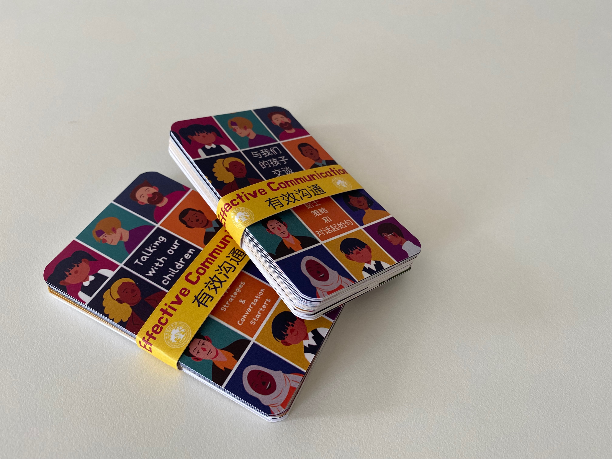
Questions
问题
Notes:
Our gift to you

